Slide 1

Week 10 – Graphic Design

Slide 2
Outline
The Role of Graphic Design
Principles of Graphic Design
Animation/Rollovers
Typography
Color

Slide 3
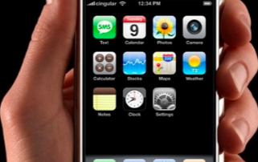

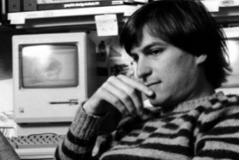
What is design?
“Design is not just what it looks like and feels like. Design is how it works.”
Steve Jobs

Slide 4
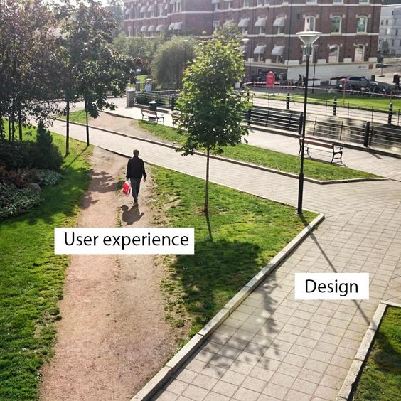
What is Bad Design

Slide 5
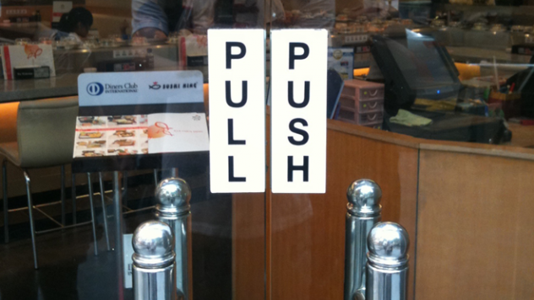

Slide 6
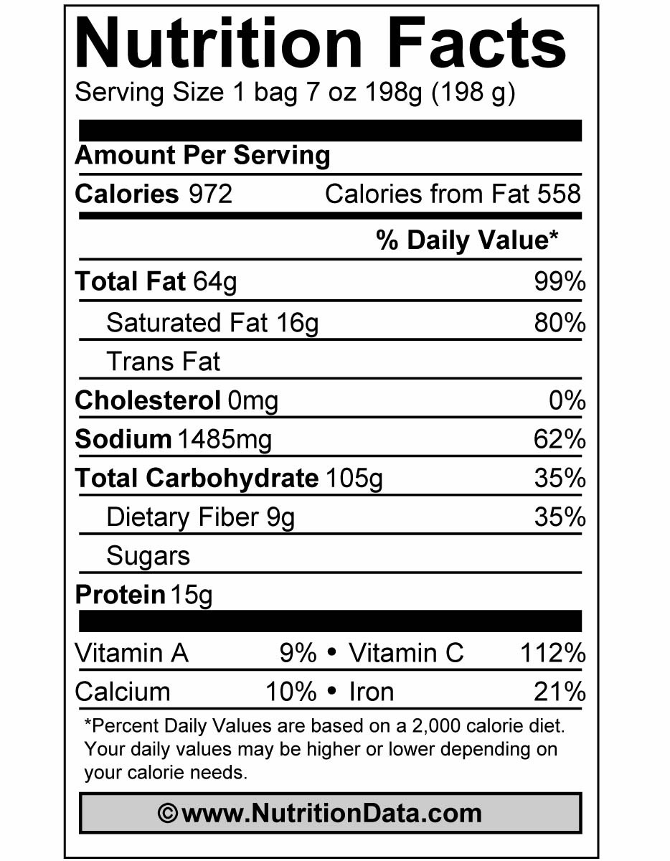
Graphic Design (Communication Design)
Act of creating a communicative artifact: print piece, web site, way finding system, data visualization, illustration, etc.
Requires an awareness of the social and cultural systems within the context of use
Intention of information transfer, both of text and subtext
Not just content, also feeling
Intention of specific user action or other outcome

Slide 7
Principles of Graphic Design
Concept: what is the overarching idea that every visual aspect of the interface relates to? (It MUST be relevant)
Metaphor: (Means of “explaining” concept) If you’re building an interface for a grocery application, maybe mimic a person walking through a store with a cart.
Hierarchy: What are the relative “levels” of importance? What should the user see first? Second?

Slide 8
Principles of Graphic Design
Clarity: Every element in an interface should have a reason for being there.
“Less is more”
White space
Leads the eye
Provides symmetry and balance through its use
Strengthens impact of message
Allows eye to rest between elements of activity (increases legibility)
Used to promote simplicity, elegance, refinement

Slide 9
Principles of Graphic Design
Consistency: Be consistent in every aspect:
In layout, color, images, icons, typography, text
Within screen, across screens
Stay within metaphor everywhere
Platform may have a style guide -- follow it!
Alignment
Western world: start from top left
Allows eye to parse display more easily
Grids:
(Hidden) horizontal and vertical lines to help locate window components
Group items logically
Minimize number of controls, reduce clutter

Slide 10
Principles of Graphic Design
Grids – use them

Slide 11
Principles of Graphic Design
Alignment:
Left, center, or right
Ragged right or justified
Justiﬁcation without hyphenation slows reading due to gaps between words.
Use either ﬂush left, or justiﬁed with hyphenation.
Choose one, use it everywhere
Novices often center things
Hard to read!
No definition, calm, very formal
Use only in small quantities

Slide 12
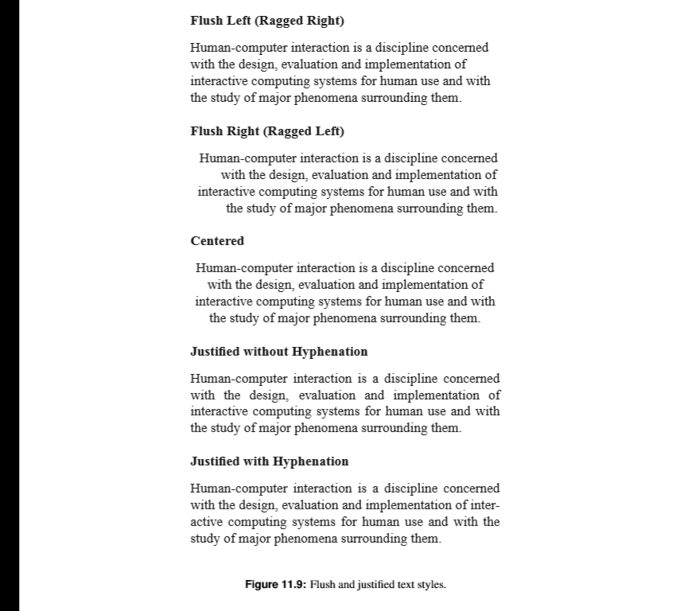
Alignment

Slide 13
Principles of Graphic Design
Proximity:
Items close together appear to have a relationship
Large distance implies -- no relationship
13
1 3
21 37
21 37

Slide 14
Principles of Graphic Design
Contrast
Take advantage of contrast to guide user through hierarchy of information; add focus; or to energize an interface with “texture”
Can be used to distinguish active control
Ask yourself what is the most important item in the interface, highlight it

Slide 15
Animation/Rollovers
Blinking
Good for grabbing attention, but easily becomes obnoxious; use very sparingly

Slide 16
Topics in Communication Design
Typography
Color
Design Systems

Slide 17
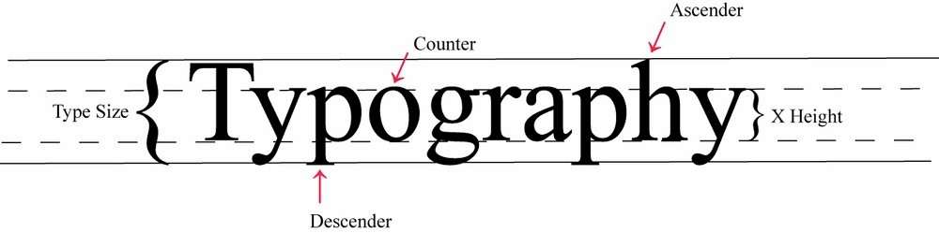
Anatomy of a Typeface
a typeface is a set of type families of a unifying and distinctive design (for instance, Times Roman)
a font is one instance of that family (Times Roman light italic)
standard measuring unit is the point, measured from top of ascender to bottom of descender

Slide 18
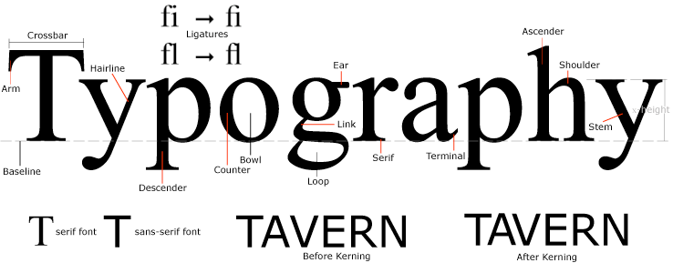
More on Type
two kinds of type, serif and sans serif

Slide 19
More on Type
the relationships between type and space around it makes paragraphs look diﬀerent:
size of x-height
type size
leading
line length

Slide 20
type x-height
Tiramisu displays real-time arrival information when a commuter is actively sharing GPS (figure 2C). When this is not available, the system shows historic arrival information, assuming the system has previous trace data for this bus at this time. When neither real-time nor historic arrival information are available, the interface shows the scheduled arrival time. In addition, the interface shows bus fullness information, something currently not available as an estimate in the schedule provided by the transit service. (11 pt Bernhard Modern)
Tiramisu displays real-time arrival information when a commuter is actively sharing GPS (figure 2C). When this is not available, the system shows historic arrival information, assuming the system has previous trace data for this bus at this time. When neither real-time nor historic arrival information are available, the interface shows the scheduled arrival time. In addition, the interface shows bus fullness information, something currently not available as an estimate in the schedule provided by the transit service. (11 pt Garamond)
Tiramisu displays real-time arrival information when a commuter is actively sharing GPS (figure 2C). When this is not available, the system shows historic arrival information, assuming the system has previous trace data for this bus at this time. When neither real-time nor historic arrival information are available, the interface shows the scheduled arrival time. In addition, the interface shows bus fullness information, something currently not available as an estimate in the schedule provided by the transit service. (11 pt Taz)
Tiramisu displays real-time arrival information when a commuter is actively sharing GPS (figure 2C). When this is not available, the system shows historic arrival information, assuming the system has previous trace data for this bus at this time. When neither real-time nor historic arrival information are available, the interface shows the scheduled arrival time. In addition, the interface shows bus fullness information, something currently not available as an estimate in the schedule provided by the transit service. (11 pt Gill Sans)

Slide 21
leading and line length
Tiramisu displays real-time arrival information when a commuter is actively sharing GPS (figure 2C). When this is not available, the system shows historic arrival information, assuming the system has previous trace data for this bus at this time.
When neither real-time nor historic arrival information are available, the interface shows the scheduled arrival time. In addition, the interface shows bus fullness information, something currently not available as an estimate in the schedule provided by the transit service.
To share GPS traces, commuters decide on the bus they wish to take, they select that bus from the list of arrival times, transitioning the interface to the “Destination” screen (Figure 2D). Here they select from a list of upcoming stops. Making a selection transitions the interface to the “Record” screen (Figure 2E).
Once they board the bus, commuters
indicate fullness and press the “Start Recording” button to share the fullness rating and the GPS trace.
While tracing, Tiramisu displays the next stop (Figure 2F). At the end of the trip, commuters press a stop recording button (Figure 2F) as they exit.
Tiramisu displays real-time arrival information when a commuter is actively sharing GPS (figure 2C). When this is not available, the system shows historic arrival information, assuming the system has previous trace data for this bus at this time. When neither real-time nor historic arrival information are available, the interface shows the scheduled arrival time. In addition, the interface shows bus fullness information, something currently not available as an estimate in the schedule provided by the transit service.
To share GPS traces, commuters decide on the bus they wish to take, they select that bus from the list of arrival times, transitioning the interface to the “Destination” screen (Figure 2D). Here they select from a list of upcoming stops. Making a selection transitions the interface to the “Record” screen (Figure 2E). Once they board the bus, commuters indicate fullness and press the “Start Recording” button to share the fullness rating and the GPS trace. While tracing, Tiramisu displays the next stop (Figure 2F). At the end of the trip, commuters press a stop recording button (Figure 2F) as they exit.
Tiramisu displays real-time arrival information when a commuter is actively sharing GPS (figure 2C). When this is not available, the system shows historic arrival information, assuming the system has previous trace data for this bus at this time. When neither real-time nor historic arrival information are available, the interface shows the scheduled arrival time. In addition, the interface shows bus fullness information, something currently not available as an estimate in the schedule provided by the transit service.
To share GPS traces, commuters decide on the bus they wish to take, they select that bus from the list of arrival times, transitioning the interface to the “Destination” screen (Figure 2D). Here they select from a list of upcoming stops. Making a selection transitions the interface to the “Record” screen (Figure 2E). Once they board the bus, commuters indicate fullness and press the “Start Recording” button to share the fullness rating and the GPS trace. While tracing, Tiramisu displays the next stop (Figure 2F). At the end of the trip, commuters press a stop recording button (Figure 2F) as they exit.

Slide 22
type “etiquette”
larger x-heights are often easier to read at small sizes, but look dense when leading is tight
tight leading makes long bodies of text hard to read, especially if the line length is long
long lines of type (>70 characters) are hard to read
very short lines break up text into non-syntactic groups of 2-3 words
justified text often creates river
just don’t center!!!!
AVOID HEAVY USE OF ALL UPPERCASE

Slide 23
choosing type for your design
take an inventory of text elements you need (ex: head, subhead, footnotes).
choose a type family or two to work with — no font salads
make sure faces look good together and support intended voice
find suitable sizes for each of the elements create guidelines and maintain them
test line length and leading if applicable
look at short and long pieces of text

Slide 24
working with type
use of ALL CAPS or all italic slows reading
readers pay attention to contrast among typographic elements
changes in weight (bold, etc.) may be noticed more than changes in typeface
reversed type (white letters on a black or colored background) is a strong visual element and should be used sparingly
white space helps to create visual tension and clusters of related elements

Slide 25
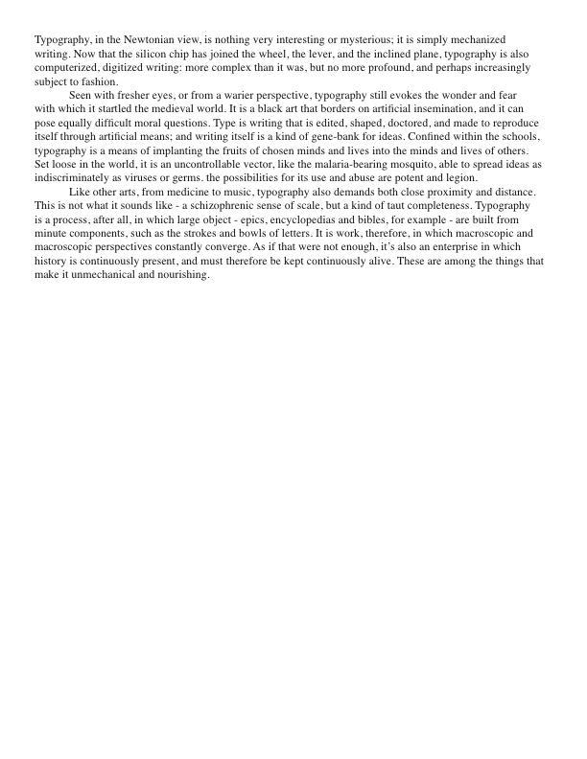

Slide 26
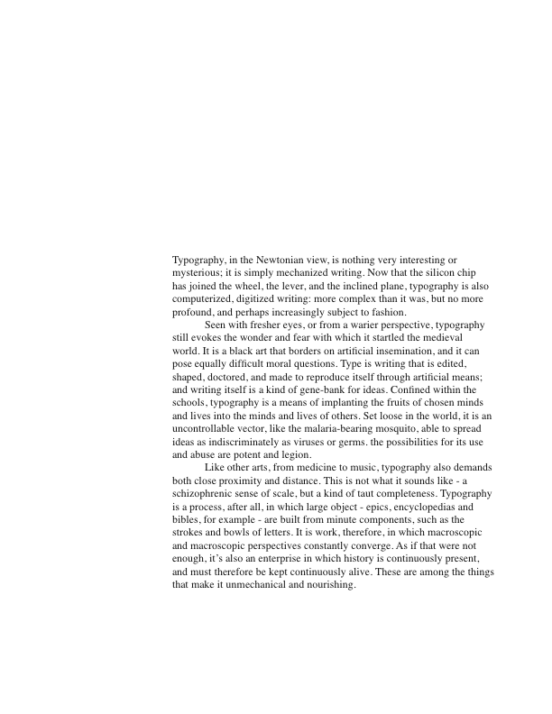

Slide 27
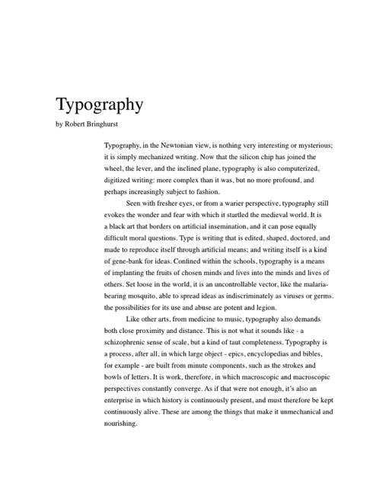

Slide 28
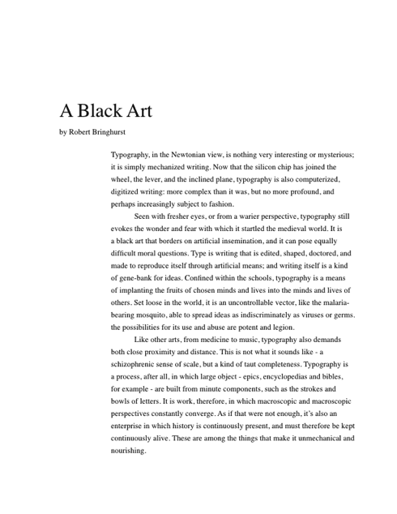

Slide 29
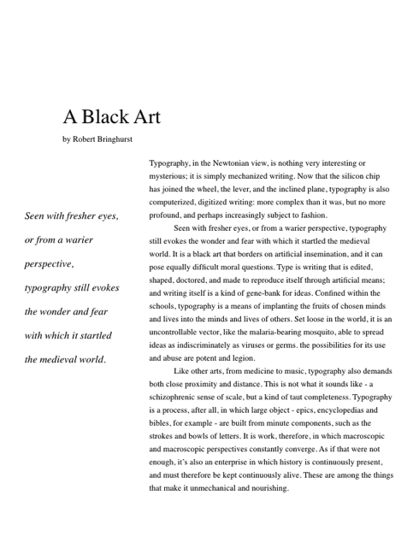

Slide 30
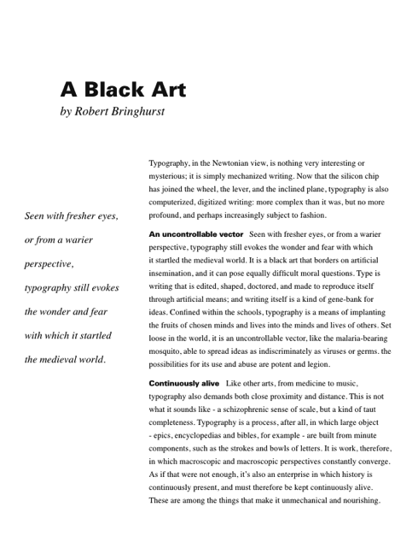

Slide 31
Color Guidelines
Color is good for supporting search
Do not use color without another redundant cue
Color-blindness
Monochrome monitors
Redundant coding enhances performance
Be consistent with color associations from jobs and cultures
Limit coding to 8 distinct colors (4 better)
Avoid using saturated blues for text or small, thin lines
Use color on b/w or gray, or b/w on color
To express difference, use high contrast colors (and vice versa)
Make sure colors do not “vibrate”

Slide 32
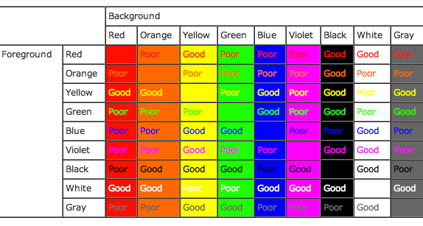
Color Contrasts

